Slide 1
Systems Administration

Slide 2
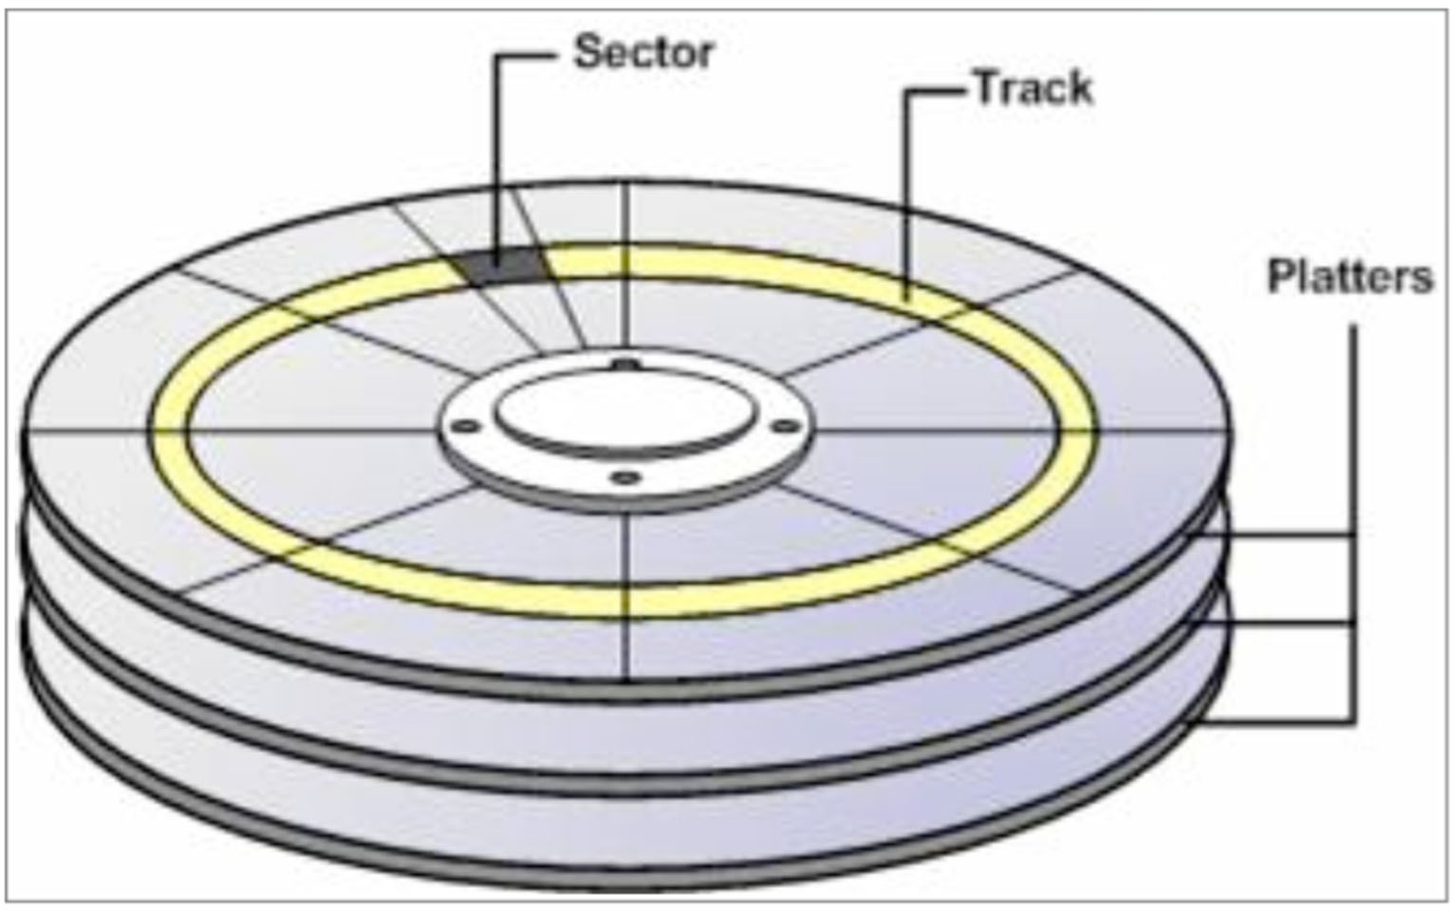


Disks – remember this diagram?

Slide 3
Disks typically have surface defects resulting in unusable sectors.
At the factory, the disk is tested and all bad sectors are identified.
The disk then arranges to use alternate sectors for the bad locations.
Some number of sectors are reserved for alternate sectoring.

Slide 4
Once in operation a disk may develop sectors.
If this happens the disk will normally adjust – however data/ file system may become corrupted.
Systems normally provide a way to perform surface analysis of disk e.g. format.
– Don’t reformat new drives as a matter of course
Such analysis can be destructive or non-destructive.

Slide 5
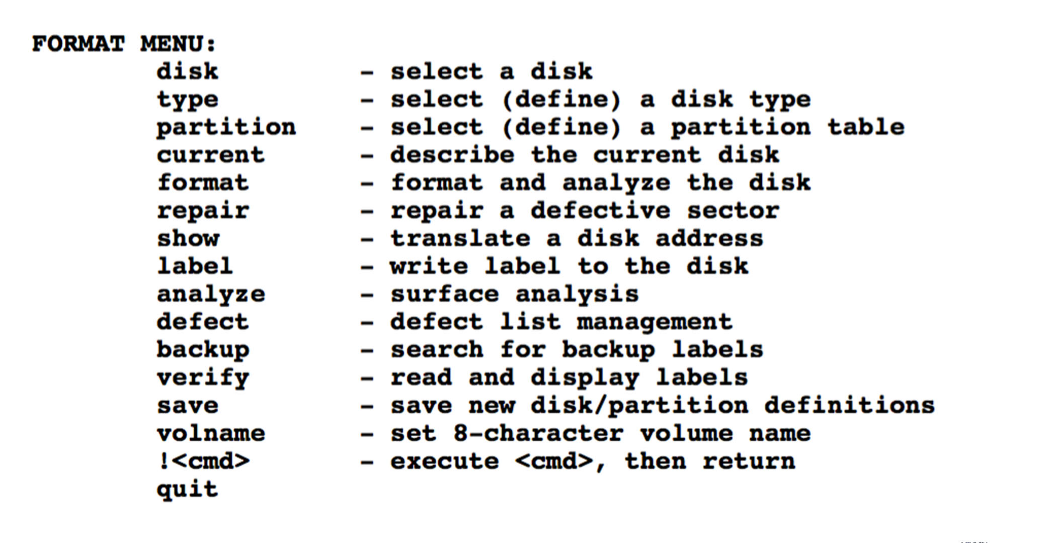
Output of Solaris (UNIX) format command
As administrators we have the ability to describe the layout of a disk.
One physical disk can be broken down into a number of logical disks. This is done by format.
These logical disks are called partitions.
Each partition can have a file system layered on top of it making it usable in a computer. This is done by newfs.

Slide 6
The software side of storage
Software components mediate between the raw storage devices and the filesystem hierarchy
Device drivers
Partitioning conventions
RAID implementations
Logical volume managers
Systems for virtualising disks over a network
The filesystem implementations

Slide 7





Filesystems, swap areas, database storage
Logical volumes
Partitions
RAID arrays
Volume groups
Storage devices

Slide 8
A storage device is anything that looks like a disk
A hard disk
A flash drive
An SSD
An external RAID array implemented in hardware
A network service that provides block-level access to a remote device
As long as the device allows random access, handles block I/O, and represented by a device file.

Slide 9
A partition is a fixed-size subsection of a storage device.
Each partition has its own device file.
Most partitioning schemes consume a few blocks at the start of the device to record the range of blocks that make up each partition.
You probably are familiar with Windows-partitioned disks.

Slide 10
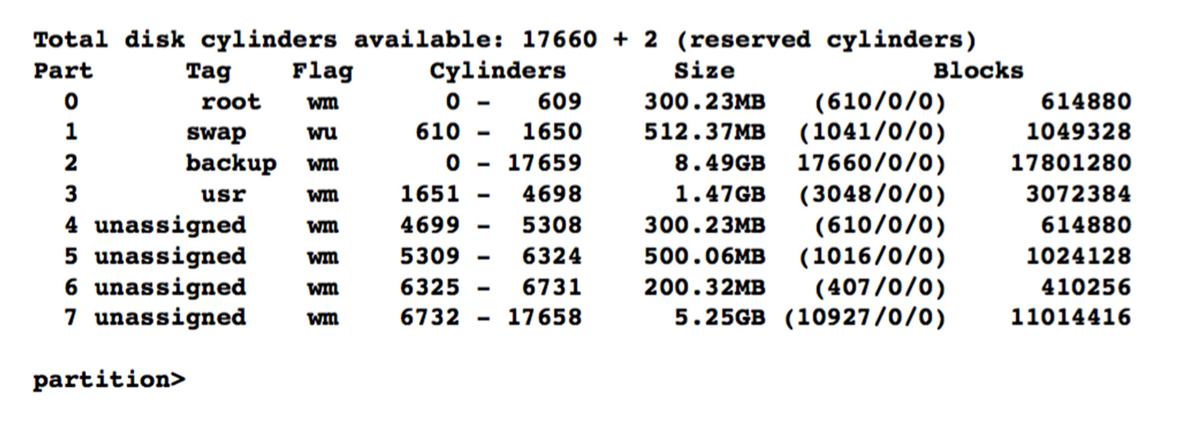
Above is the output from the Solaris format command during a partition process

Slide 11
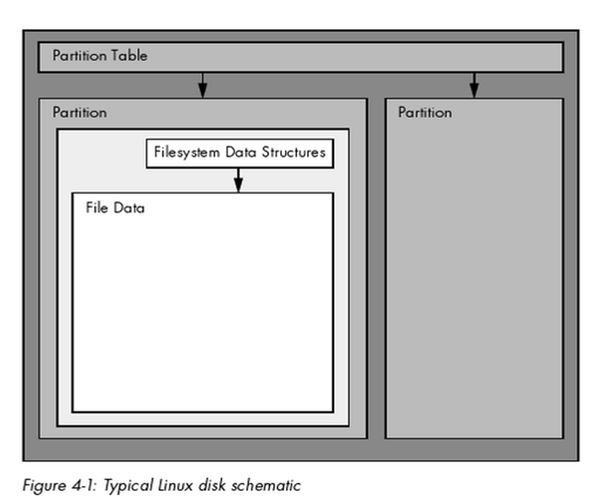
Linux partitions

Slide 12
Partitions are useful to keep data types separate:
Operating system partition (don’t want user data corrupting OS)
User data partition (don’t want this to change when OS being patched)
Swap partitions – extend memory capability
Backup partitions
Its possible to change partitions – however must be done with care
Its not easy to retrieve data that has been over written because of change of partition
Don’t alter partitions that are currently in use

Slide 13
A RAID array (a redundant array of inexpensive/independent disks) combines multiple storage devices into one virtualised device.
This is to
Increase performance
Increase reliability
Or both
RAID is typically conceived of as an aggregation of bare drives
Modern implementations let you use as a component of a RAID array anything that acts like a disk

Slide 14
Volume groups and logical volumes are associated with logical volume managers (LVMs)
Physical devices are aggregated to form volume groups
Volume groups can then be subdivided into logical volumes.
– Very similar to disk partition
For example, a 750GB disk and a 250GB disk could be aggregated into a 1TB volume group and then split into two 500GB logical volumes

Slide 15








Traditional data disk partitioning scheme
Filesystem layer
/home
/opt
/spare
Partition layer
/dev/sda1
/dev/sda2
/dev/sdb1
Physical layer
Hard disk 1 (/dev/sda)
Hard disk 2 (/dev/sdb)

Slide 16
Disk devices on Linux
Disk device files are shown as /dev/sda etc.
sda: first registered device
sda1: first partition of sda
Disk names are assigned in sequence as the kernel enumerates the various interfaces and devices on the system
Subdirectories under /dev/disk list disks by various stable characteristics such as their manufacturer ID
parted –l lists the sizes, partition tables, model numbers, and manufacturers of every disk on the system

Slide 17
Other OS use different naming conventions for device files
For example, Solaris use /dev/dsk/cWtXdYsZ
W is the controller number
X is the SCSI target number
Y is the SCSI logical unit number (almost always 0)
Z is the partition number
You see something like /dev/dsk/c2t1d0s1

Slide 18
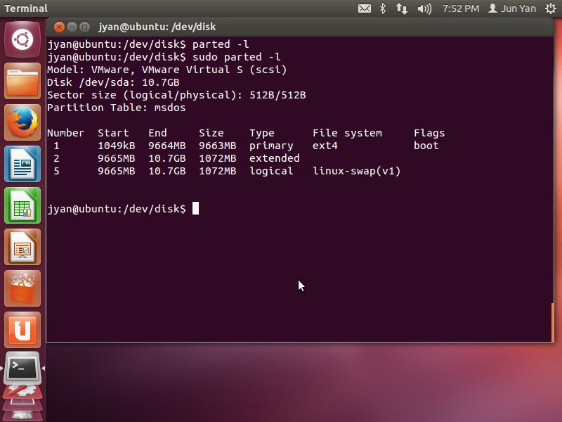

Slide 19
Root partition
All systems have a root partition that includes / and most of the local host’s configuration data
Everything needed to bring the system up to single-user mode is part of the root partition
Various subdirectories (/var, /usr, /tmp, /home) may be broken out into their own partitions or volumes
Most systems also have at least one swap area

Slide 20
Some general partitioning points
Have a backup root device that you can boot to
Put /tmp on a separate filesystem to limit temporary files to a finite size
It’s a good idea for /var to be a separate disk partition
Put users’ home directories on a separate partition or volume.
Split swap space among several physical disks
Backups of a partition may be simplified if the entire partition can fit on one piece of media

Slide 21
Linux partitioning
The fdisk command is a basic command-line partitioning tool but it is not designed for large partitions
The parted command is a fancier command-line tool that can move and resize partitions in addition to simply creating and deleting them
A GUI version of parted is gparted which lets you specify the size of the partition
You can also use cfdisk

Slide 22
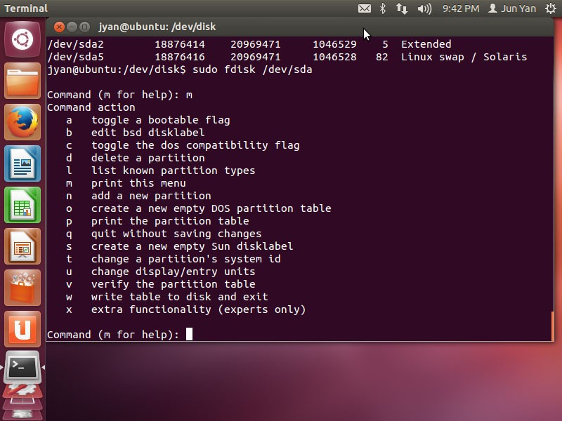
22
Document title

Slide 23
I just want to add a disk (Linux recipe)
Attach the disk and reboot
Run sudo fdisk –l to list the system’s disks and identify the new drive
Run fdisk to add new partitions (you can also use
parted)
Format the newly created partitions using mkfs
command, e.g.,
– mkfs –t ext4 /dev/sda4
Mount the filesystem (need to create mount point)
Set mount options by editing /etc/fstab (mount the filesystem at startup)

Slide 24
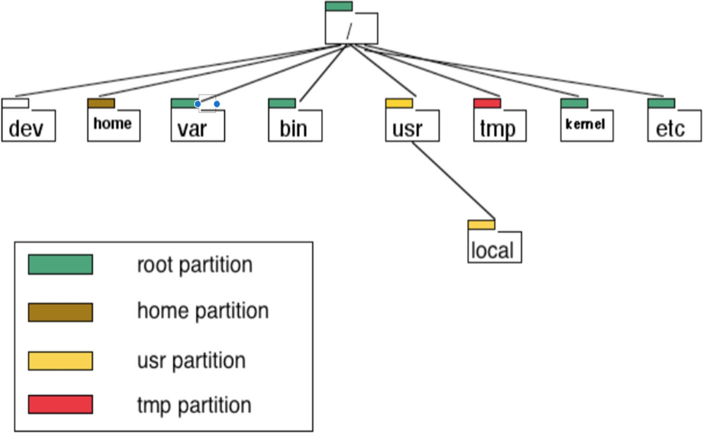
A sample filesystem in reference to the partitioning scheme on a disk

Slide 25
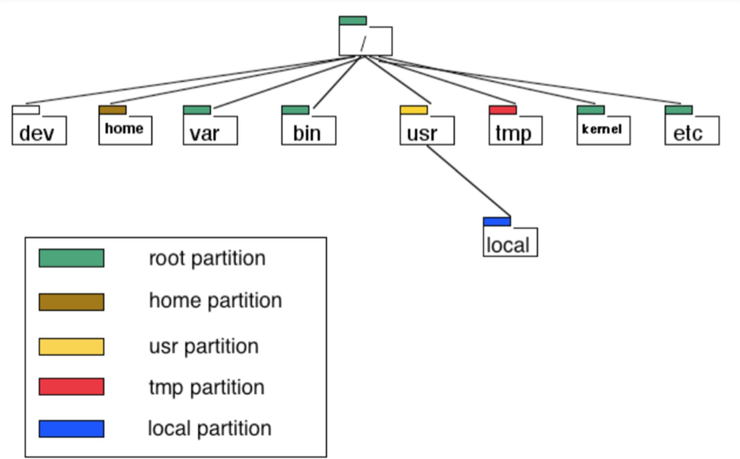
Lets say /usr/local is full. We can simply purchase another disk, create a file system on it and mount it as /usr/local

Slide 26
The mount command can take several options. In order to mount a filesystem, you must know the following:
The filesystem’s device (such as a disk partition; where the actual filesystem data resides).
The filesystem type.
The mount point —that is, the place in the current system’s directory hierarchy where the file system will be attached.
I can even mount NFS file systems or even FTP services into the file system map.
mount wraith:/open /mnt
mount_ftp ftp.uow.edu.au /mnt

Slide 27
Mounting files systems on startup
A list of file systems that are mounted on a particular system at startup are kept in fstab file:
Solaris
BSD/Linux
/etc/vfstab
/etc/fstab
Building further from earlier LINUX partitioning and formatting exercise updating the /etc/fstab file.
Open /etc/fstab file, enter:
– $ vi /etc/fstab

Slide 28
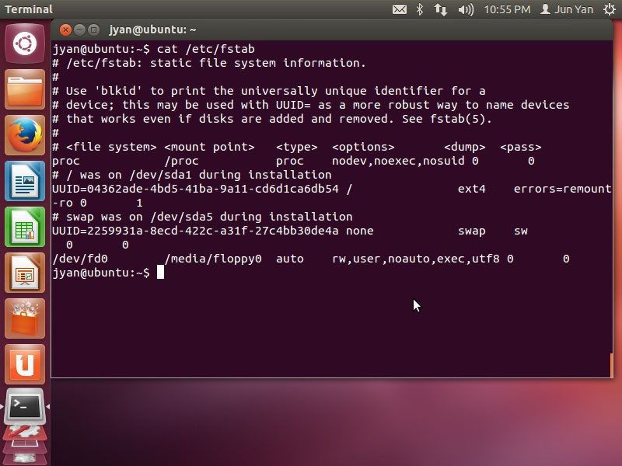

Slide 29
Append the following line to fstab file.
/dev/sdb1 /disk1 ext4 defaults 1 2
Each line corresponds to one filesystem, each of which is broken into six fields.
The device or UUID. Most current Linux systems no longer use the device in /etc/fstab , preferring the UUID.
The mount point Indicates where to attach the filesystem.
The filesystem type
Options – default: This uses the mount defaults: read-write mode, enable device files, executables, the setuid bit, and so on
Backup information for use by the dump command.
The filesystem integrity test order

Slide 30
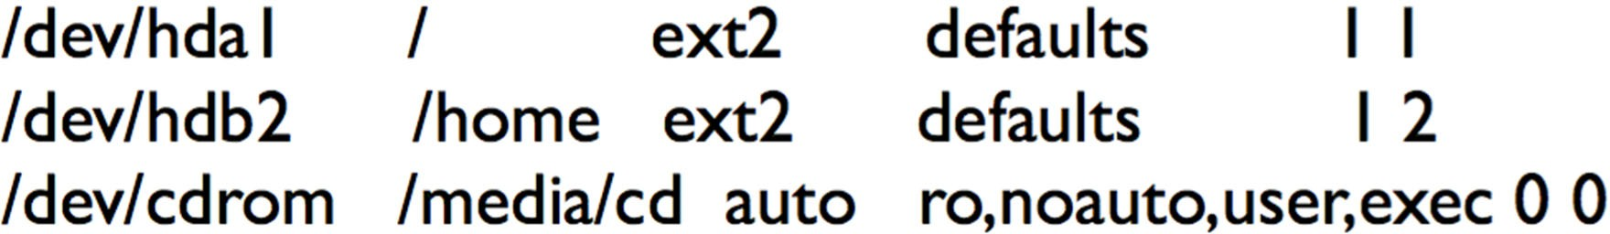
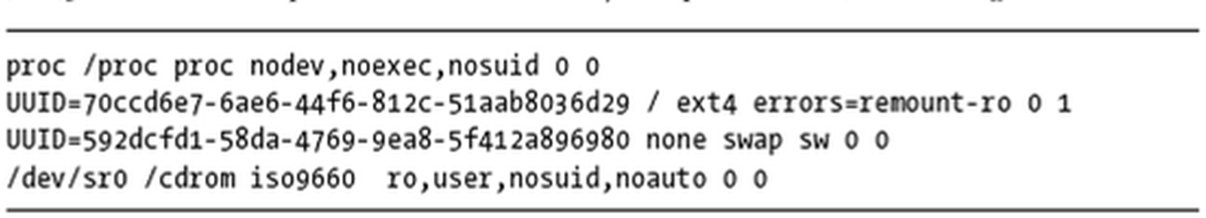
Examples

Slide 31
Universally Unique Identifier (UUID)
The method of mounting filesystems discussed in the preceding slides depends on device names. However, device names can change because they depend on the order in which the kernel finds the devices. To solve this problem, you can identify and mount file systems by their Universally Unique Identifier (UUID), a software standard. The UUID is a type of serial number, and each one should be different. File system creation programs like mke2fs generate a UUID identifier when initializing the file system data structure.

Slide 32
More on Options List:
defaults This uses the mount defaults: read-write mode, enable device files, executables, the setuid bit, and so on. Use this when you don’t want to give the filesystem any special options but you do want to fill all fields in /etc/fstab .
errors This ext2-specific parameter sets the kernel behavior when the system has trouble mounting a filesystem. The default is normally errors=continue , meaning that the kernel should return an error code and keep running. To have the kernel try the mount again in read-only mode, use errors=remount-ro . The errors=panic setting tells the kernel (and your system) to halt when there is a problem with the mount.
noauto This option tells a mount -a command to ignore the entry. Use this to prevent a boot-time mount of a removable-media device, such as a CD-ROM or floppy drive.
user This option allows unprivileged users to run mount on a particular entry, which can be handy for allowing access to CD- ROM drives

Slide 33
RAID
The idea is to use a cluster of small disks as a group to simulate a larger device and at the same time provide a mechanism whereby a single disk failure did not result in the data becoming unavailable.
Hardware implementation has been predominate in the past but things are changing.

Slide 34
RAID
RAID can improve performance by striping data across multiple drives, thus allowing several drives to work simultaneously to supply or absorb a single data stream
RAID can replicate data across multiple drives, decreasing the risk associated with a single failed disk
Mirroring: data blocks are reproduced “bit-by-bit”
– Parity scheme: one of more drives contain an error- correcting checksum of the blocks on the remaining data drives

Slide 35
RAID levels
0 striped disk (no redundancy)
1 mirrored disk
0+1 mirrored and striped (often called10)
2 minor variation of 3 not used
3 striping by byte/word with parity
4 striping by block with parity drive
5 striping by block with rotating parity
6 striping by block with rotating parity in two parity disks

Slide 36
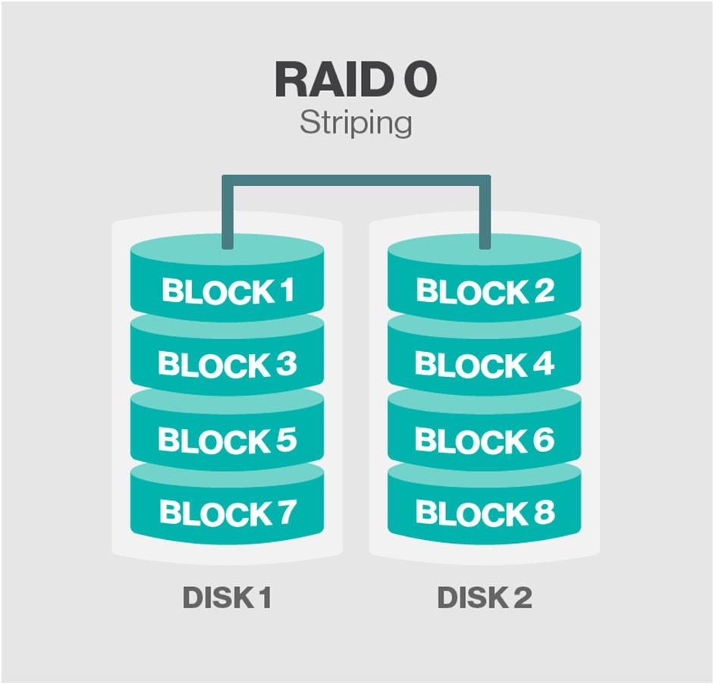
RAID 0
This configuration has striping but no redundancy of data. It offers the best performance but no fault-tolerance.

Slide 37
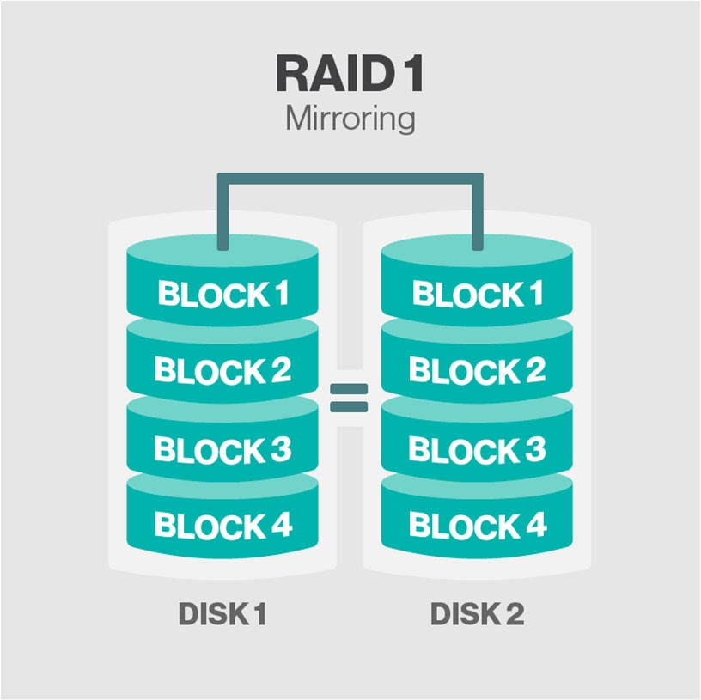
RAID 1
Also known as disk mirroring, this configuration consists of at least two drives that duplicate the storage of data. There is no striping. Read performance is improved since either disk can be read at the same time. Write performance is the same as for single disk storage.

Slide 38
Nested RAID Arrays
Some RAID levels are referred to as nested RAID because they are based on a combination of RAID levels. Here are some examples of nested RAID level.
RAID 10 (RAID 1+0): Combining RAID 1 and RAID 0, this level is often referred to as RAID 10, which offers higher performance than RAID 1 but at a much higher cost. In RAID 1+0, the data is mirrored and the mirrors are striped.

Slide 39
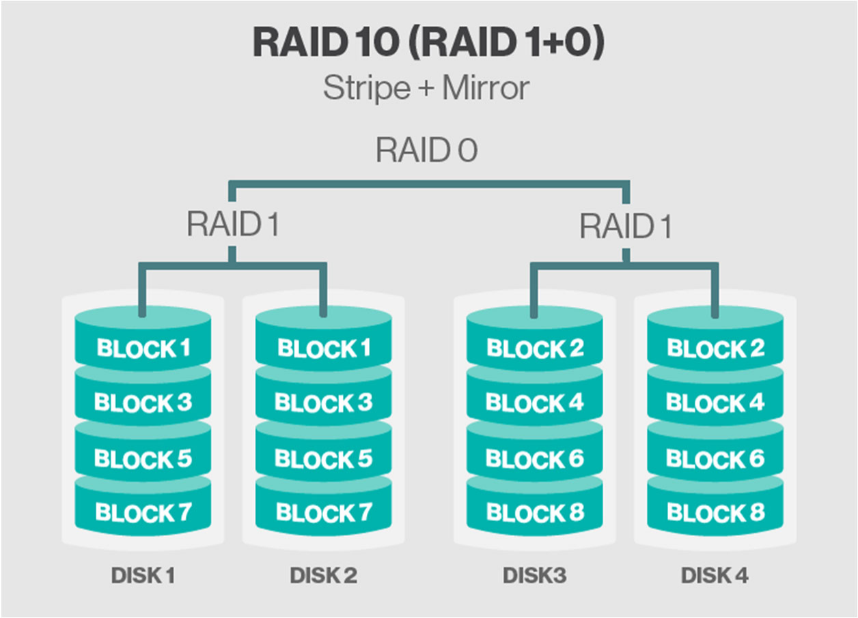

Slide 40
ECC – Error Checking and Correcting
Raid 2-6 include ECC techniques to provide additional data redundancy measures .
Parity data is used by some RAID levels to achieve redundancy. A certain checksum is calculated which then is written to a disk. If a drive in the array fails, remaining data on the other drives can be combined with the parity data (e.g. using the Boolean XOR function or Reed Solomon code) to reconstruct the missing data.

Slide 41
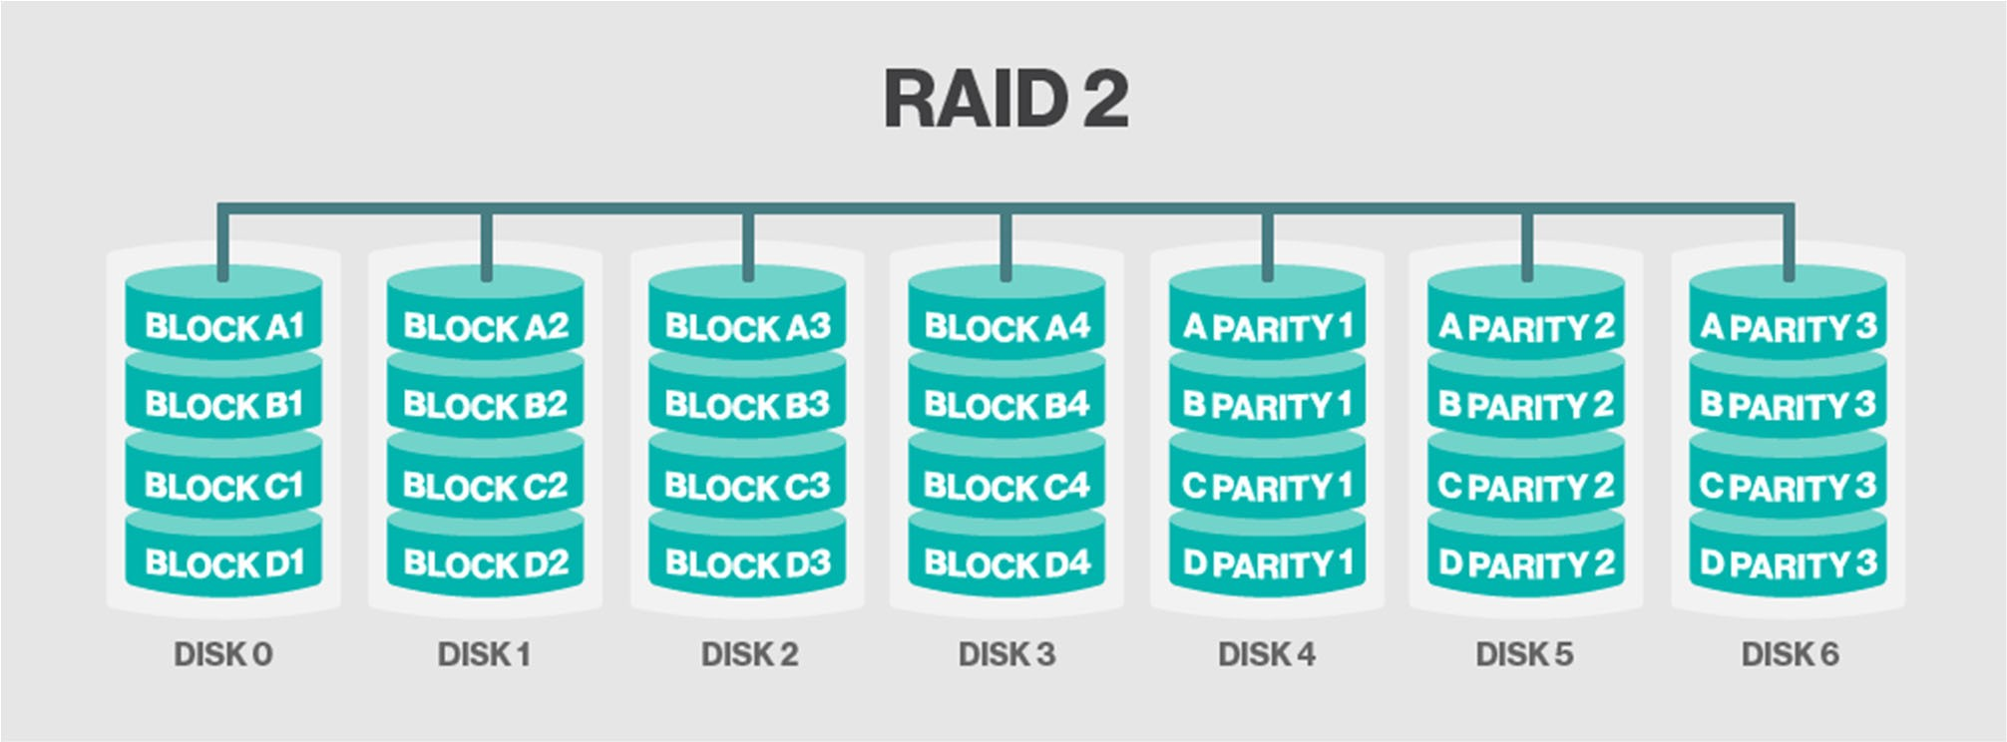
RAID 2 (no longer used)

Slide 42
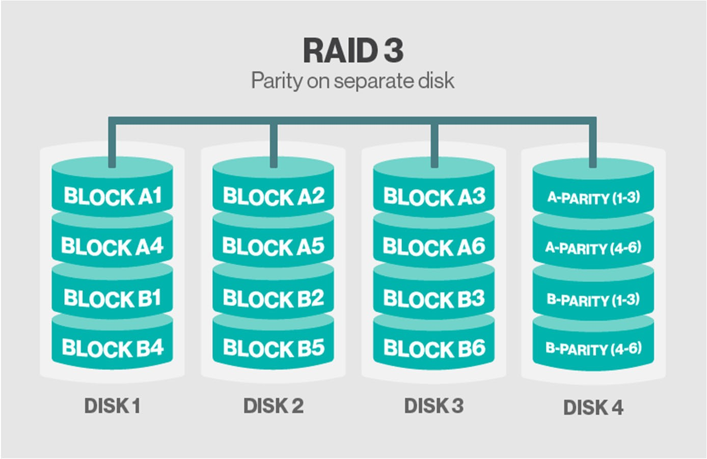
RAID 3
RAID 3 is best for single-user systems with long record applications, such as streaming media, graphics and video editing.

Slide 43
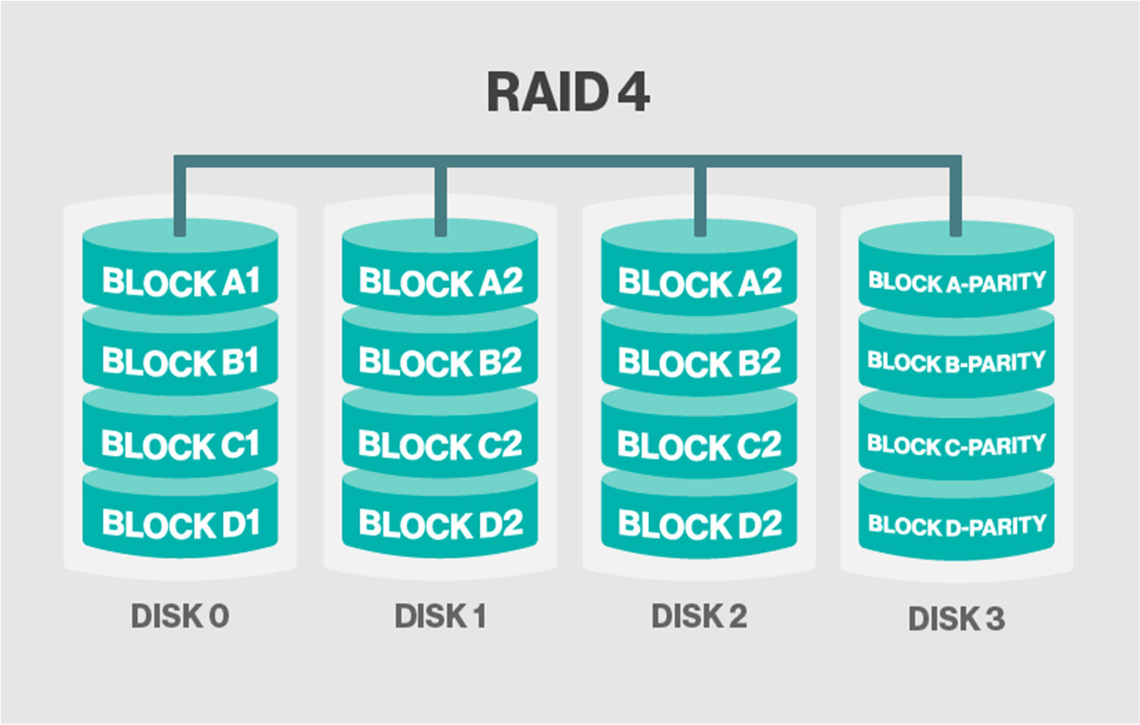
RAID 4
RAID 4 offers no advantage over RAID 5

Slide 44
RAID 4
Imagine you have 9 disk drives.
Your logical disk block size is 8K.
Each logical disk block comprises 1K from each of the first 8 disk drives.
When an 8K block is written, the first 1K goes to disk1, the second 1K goes to disk 2 and so on.
To read back an 8K block, 1K is read from each disk drive and the 1K blocks concatenated to form the original 8K block.

Slide 45
Reading and writing to each of the 8 drives runs in parallel, so the time to write or read a block (8K) is improved.
To protect against a single drive failure, the 9th drive is used to write a parity block of 1K as well.
The parity block is not needed in the normal case.
However, if one of the first 8 drives fails, the data from the other 7, plus the parity information can be used to reconstruct the original 8K block.

Slide 46
This gives protection against a single drive failure.
If 2 or more drives fail there is no protection unless more parity information is written.
To protect against a single disk failure in the above example, 11% of the total storage was used for parity and therefore not available for normal use.
This idea can be expanded to any number of disk drives.
Some storage is always lost to parity information. The amount lost depends on the configuration and RAID level used. The more disks in the RAID group, the less capacity is lost to parity.
Parity blocks are constructed by XORing the contents of all the other blocks. This operation is expensive and tends to make RAID writes slow.

Slide 47
RAID 5
RAID 5 is identical to RAID 4, except the parity information is spread over all the disk drives rather than just one.
This is done to even out the I/O load on reads.
When a drive fails, the system will continue to function normally, perhaps losing some performance.
The failed drive can be replaced and the RAID system will re-create the lost data and return to normal operation.

Slide 48
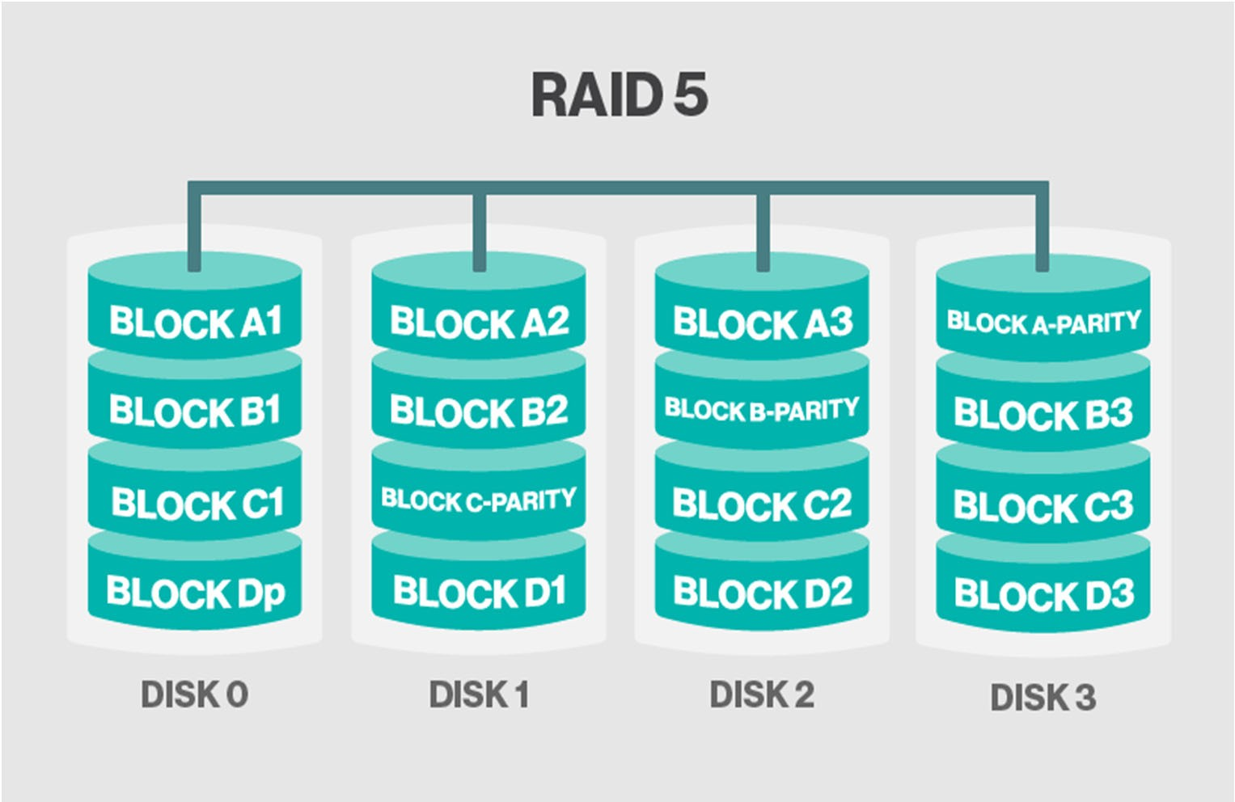

Slide 49
RAID 6
This technique is similar to RAID 5 but includes a second parity scheme (in addition to Exclusive NOR) that is distributed across the drives in the array. The use of additional parity allows the array to continue to function even if two disks fail simultaneously. However, RAID 6 arrays have a higher cost per gigabyte (GB) and often have slower write performance than RAID 5 arrays

Slide 50
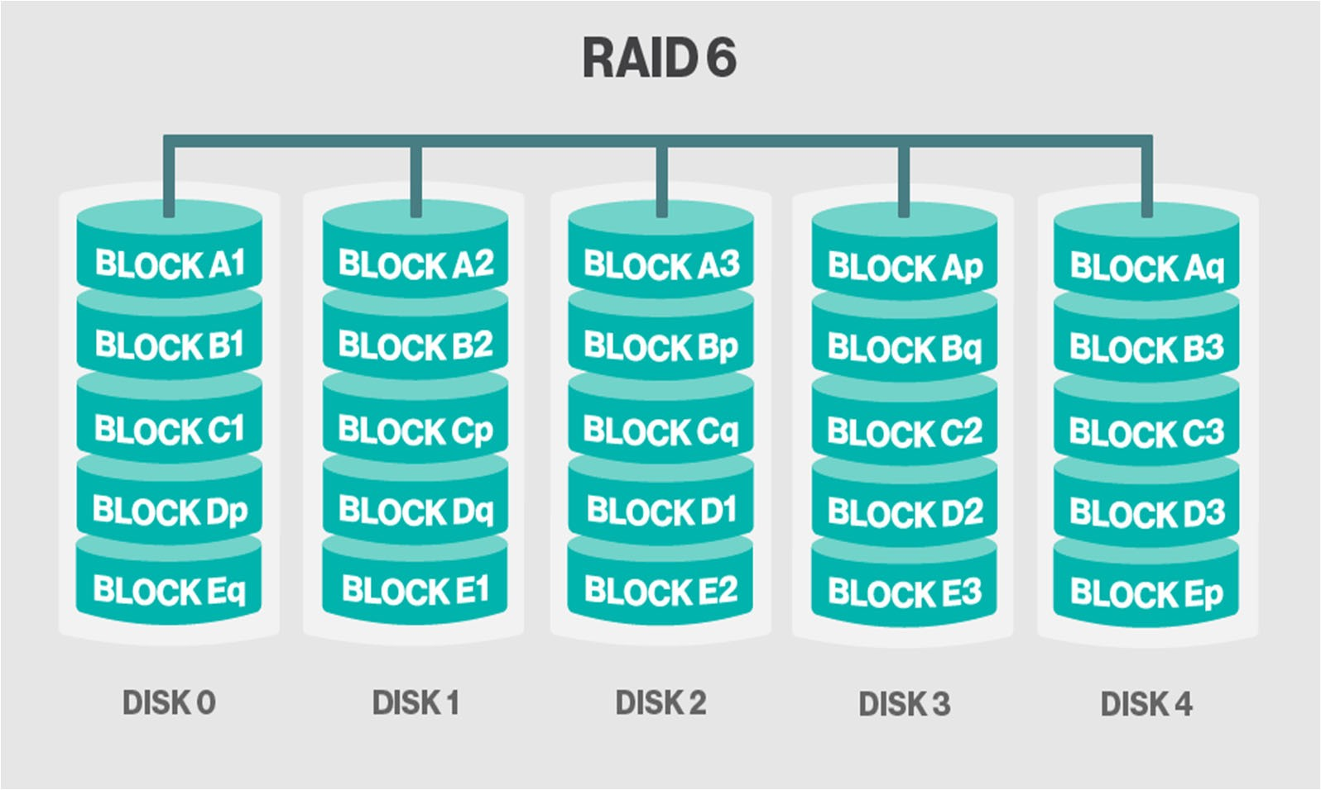

Slide 51
It is common to be using different RAID levels on different volumes in the same RAID environment, since different software systems have differing performance and reliability requirements..
Home directories may need reliability but not high performance, so use RAID 5 or 4.
Database system may need high read performance, so use 4 way RAID 1 (mirroring).

Slide 52
In any environment where data is important or uptime is important, you should consider using RAID systems for your disk storage.
Downtime due to failed disk can be very large.
Restoring filesystems from tape is very slow.

Slide 53
Logical volume management
Logical volumes are more flexible and powerful than disk partitions
Move logical volumes among different physical devices
Grow and shrink logical volumes on the fly
Take copy-on-write “snapshots” of logical volumes
Replace on-line drives without interrupting service
Incorporate mirroring or striping in your logical volumes

Slide 54
LVM implementation in Linux: LVM2
You can use either a group of simple commands or the
lvm command and its subcommands.
Physical volume is a storage device that has had an LVM label applied
Can be disks, disk partitions or RAID arrays
Create: pvcreate
Inspect: pvdisplay
Modify: pvchange
Check: pvck

Slide 55
Volume group
Create: vgcreate
Modify: vgchange
Extend: vgextend
Inspect: vgdisplay
Check: vgck
Enable: vgscan
Logical volume
Create: lvcreate
Modify: lvchange
Resize: lvresize
Inspect: lvdisplay

Slide 56
LVM examples
A simple illustration can be found at https://www.thegeekstuff.com/2010/08/how-to-create- lvm
A more detailed introduction can be found at https://www.howtoforge.com/linux_lvm

Slide 57
Linux filesystems: the ext family
The UNIX File System (UFS) formed the basis of several filesystem implementations
UNIX kernel allows multiple types of filesystems to be active at once.
In most cases, stick with the system’s defaults.
ext2 is functionally similar to UFS
ext3 adds journaling capability to the existing ext2 code
ext4 increase the performance and allows the use of “extents” (default on Ubuntu)

Slide 58
Design of File Systems
When building computer systems with storage we need to understand the structure and interactions of the file system. We also need to understand how users will use it as well. Here are a few rules which are useful for designing file systems that are scalable and more importantly manageable.
Isolate the Operating System
Ensure that the file systems used to contain the operating system are separate from the file system used for other purposes.
This minimizes the problems when new OS releases are installed since the administrator knows that other file systems can be safely preserved across OS installs.

Slide 59
Ensure areas written by applications or users are not on vital partitions.
Make sure areas such as home directories, log and spool areas are not in the OS partitions i.e. root.
This prevents some problems with the file system filling.
Group Files used for like purposes.
Use separate partitions for home directories, software packages, logs and any other functional grouping you consider reasonable.
This makes designing backup strategies simpler and prevents problems in one area affecting others.
Different creation of mount options can be used on each file system to increase performance of security in way that make sense for the different use areas.

Slide 60
Design for backups.
Do not create file systems larger than can be reasonably fit on tapes.
Allow for differing backup strategies of schedules between file systems. e.g. areas used for software can be backed up less frequently than those containing home directories
Design of File Systems
Try for flexibility - keep some disk up your sleeves. This can be difficult.
When change is needed, you can use the additional space without a major re-organisation.

Slide 61
Spread Disk load.
This improves performance due to overlapped read/ writes/seeks.
Allocate busy file systems to separate disks and controllers where possible.
Place busy file systems in the middle of the drive. Busy file systems should be adjacent to one another.
Use raw partitions for swap.
Don’t skimp on memory - you do not want swap being over utilised.
In the event you can’t have that luxury - do not skimp on the size of swap.
Monitor memory and swap usage e.g. vmstat.
Scan rate is the most important. It is the number of candidate pages being scanned per second as candidates are being freed.

Slide 62
Server redundancy
Remember that RAID protects against disk drive failure – not software or human error or failure of other components.
Power supplies – there is much value in have two parallel power supplies. This means that the server should still be able to run if one power supply fails; this is called n+1 redundancy
This means that is two power supplies are required to power the device you will need three power supplies.
Each power supply should have a separate power chord
its possible that a single power chord can be accidently disconnected;
very useful if you need to move a chord to a new power strip.
If high availability is the order of the day it makes sense to draw power from two different UPS (Uninterruptable Power Supplies)

Slide 63
Full versus n+1 redundancy
N+1 redundancy is where selected components in a system have a second item to take over should it fail
Full redundancy is where two sets of identical hardware are provided.
Sometimes are linked in a “fail-over” configuration (either manual or automatic)
Other times linked as a “load sharing” arrangement
N+1 is cheaper than full redundancy. Careful choices need to be made about what is made redundant

Slide 64
Disk and File Systems – ZFS Case study
There are a number of issues with modern file systems.
Scalability - How much can I grow?
Reliability - What happens on failure?
Consistency - Is my data consistent?
Manageability - How do I manage the file system?

Slide 65
MEET ZFS
Zetabyte File System (ZFS)
Originated with Sun Microsystems but has ports to other OSs
ZFS represents a different way of thinking about disks.
ZFS is a comprehensive approach to storage management that includes the functions of a logical volume manager and a RAID
Meets modern filesystem requirements providing redundancy, scalability, data integrity and other feature such as Snapshots, Clones and data compression

Slide 66
ZFS Features
Dynamic Striping and Redundancy (Mirroring & Raid Z/RaidZ2)
Pooled storage: physical storage devices are added to a pool, and storage space is allocated from that shared pool.
Scrubbing (live file system checks and fixes using metadata checksum - compare with fsck utility)
Data Compression.
Copy on write transactions.
Snapshots & Clones (writable snapshots).
Ability to reconstruct a dead device from healthy devices (resilvering)

Slide 67
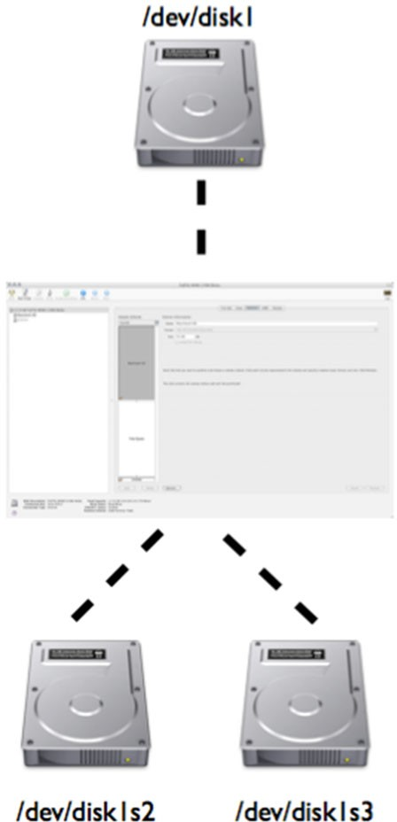
Concept: Pools
Historically disks and partitions represented volumes.
Administrators would partition these devices initially to support their needs.
Did not allow for growth or redundancy

Slide 68
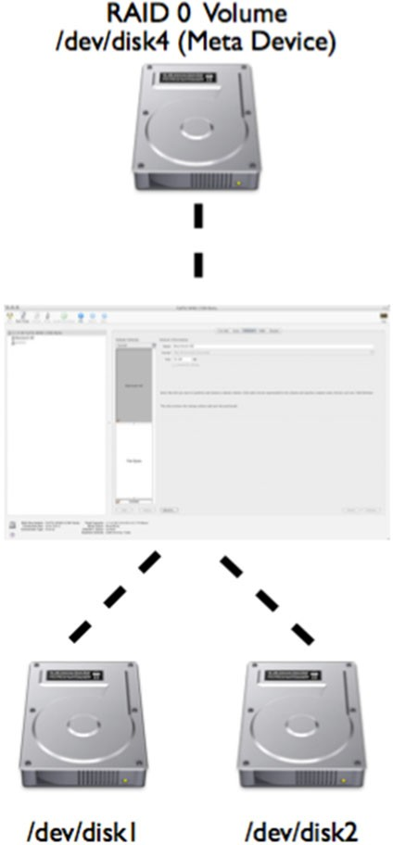
To facilitate redundancy and scalability vendors produced Volume Managers.
Volumes Managers would group devices and present virtual devices to handle growth and redundancy independent of the file system.

Slide 69
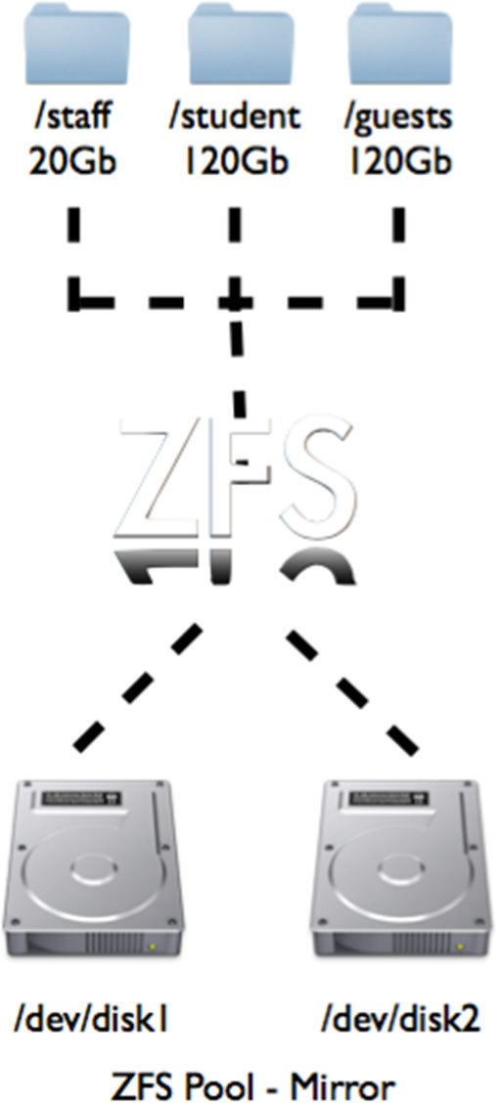
ZFS aggregates devices (disks or files) into pools.
The storage pool defines the characteristics of the storage
i.e. redundancy.
File systems are layered on top of the pool.
The pool can grow and contract, so, too, can the file systems layered on top

Slide 70
Concept Reliability
ZFS is designed to be reliable. Pools can consist of multiple devices i.e. iSCSI and Fibre channel, real disks or even partitions.
These devices can be combined into virtual devices i.e. mirrors and RAIDZ if you have more then two disks.
Data on the devices comprising mirrors and RaidZ virtual devices are striped dynamically.
All Metadata in the file system is check summed - if an error is detected it is fixed.
Each read is compared to a 256 bit checksum in meta data.
Also has a self-healing property - when errors are detected they are written to alternate blocks on the disk.
If there is an error it is read from a different device and then fixed.

Slide 71
Concept Transactions
Modern file systems implement journaling to keep transactions (blocks) on disks in a consistent state.
Failures can cause disks to be inconsistent i.e. blocks are allocated but not referenced by objects i.e. inodes on Unix File System (UFS)
By using Copy on Write, ZFS transactions are guaranteed to be consistent by always writing to new blocks (this is true for meta data blocks as well).
Blocks containing active data are never overwritten in place; instead, a new block is allocated, modified data is written to it, then any metadata blocks referencing it are similarly read, reallocated, and written.

Slide 72
By using Copy on Write, a copy of the old data blocks (and meta data) can be retained.
This means that a snapshot can be created at a specific point of the time in the file system.
Snapshots have no effect on space.
Snapshots are implemented per filesystem rather than per-volume.

Slide 73
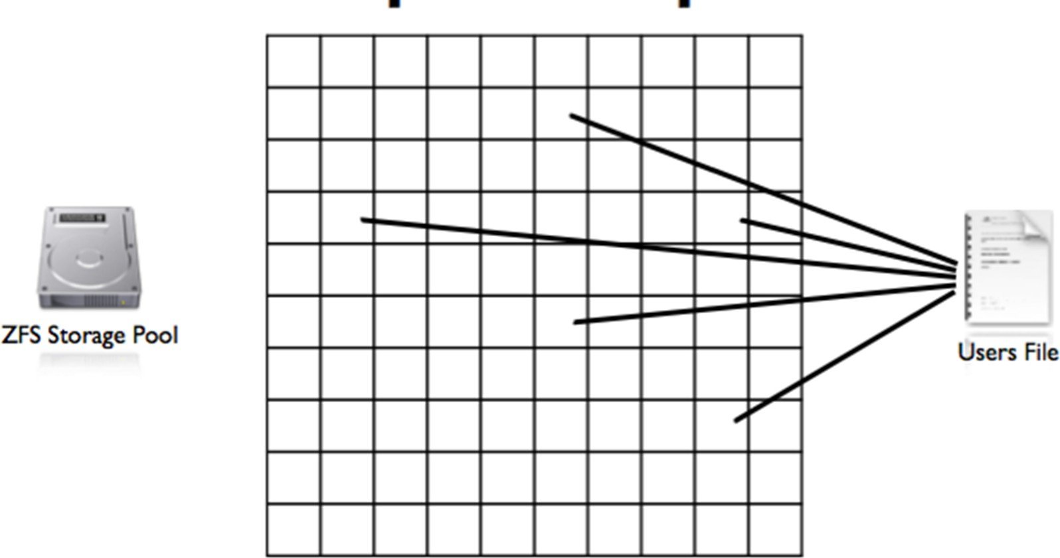
Concept: Snapshots
When a file is created blocks are allocated

Slide 74
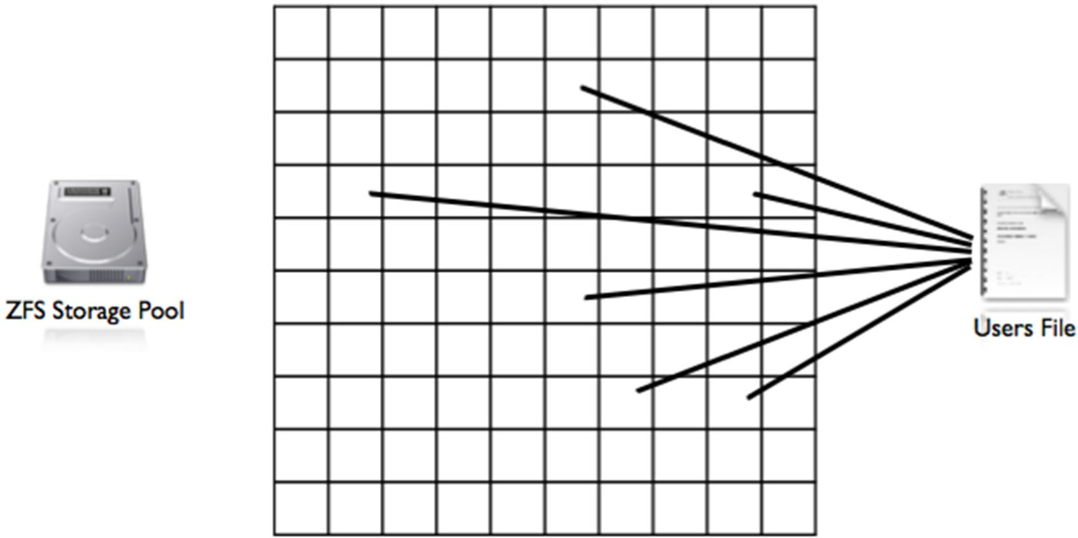
On Copy on Write, changes mean a new block is allocated with meta data changes.

Slide 75
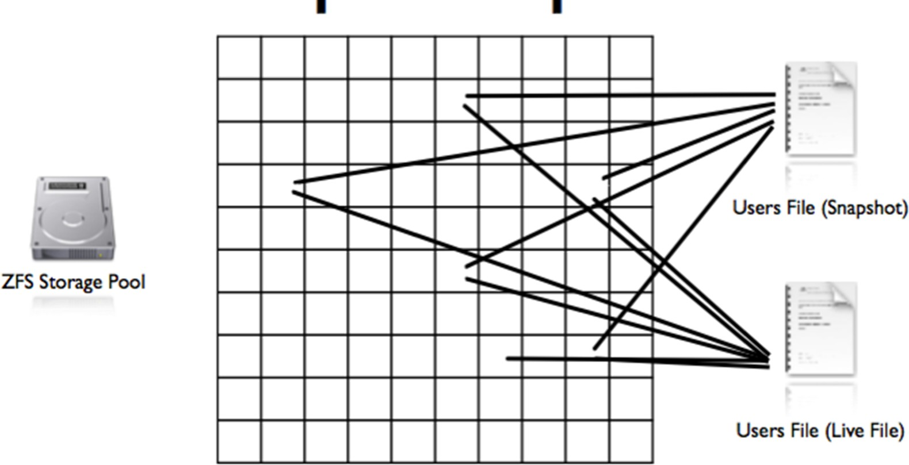
If a snapshot is made before the change then after the change we have two files.

Slide 76
Concept Clone
A clone is a ‘promoted’ snapshot.
Writeable snapshots ("clones") can also be created, resulting in two independent file systems that share a set of blocks. As changes are made to any of the clone file systems, new data blocks are created to reflect those changes, but any unchanged blocks continue to be shared, no matter how many clones exist.
As a result of being promoted it is a live file system which shares its base blocks with another.

Slide 77
Create a pool with two disks
Create a stripped pool where a copy of data is stored across all drives
sudo zpool ceate demo /dev/sdb /dev/sdc
Create a mirrored pool where a copy of data is stored across all drives
sudo zpool ceate demo mirror /dev/sdb /dev/sdc
A new filesystem is automatically created and mounted at
/demo
You can check the status of the newly created pool
sudo zpool status
sudo zpool list demo
You can also destroy a pool
sudo zpool destroy demo

Slide 78
Create a RAIDZ pool
RAID-Z is basically an improved version of RAID 5 which provides redundancy
RAID-Z requires a minimum of three hard drives
If a single disk in your pool dies, simply replace that disk and ZFS will automatically rebuild the data based on parity information from the other disks.
To make things even more redundant, you can use RAID 6 (RAID-Z2 in the case of ZFS) and have double parity
sudo zpool create demo raidz /dev/sdb /dev/sdc
/dev/sdd

Slide 79
Create filesystem
A ZFS file system can be easily created
sudo zfs create demo/fs1
To view a filesystem that is created
sudo zfs list demo
To limit the usage of filesystem, we define reservation and quota
zfs set quota=500m demo/fs1
zfs set reservation=200m demo/fs1
To change mount point for the filesystem
zfs set mountpoint=/test demo/fs1

Slide 80
ZFS snapshots
ZFS allows you to create instantaneous snapshots which are read-only copies of the file system
zfs snapshot $fs@$snapshotname
zfs snapshot demo/fs1@version1
You can see all the snapshots created
zfs list –t snapshot
A snapshot can be used to roll back to a previous state
zfs rollback demo/fs1@version1

Slide 81
ZFS clones
ZFS snapshots are not true filesystems. You can instantiate a snapshot as a full-fledged filesystem by cloning it.
A clone is a read-write copy based on a snapshot.
– zfs clone demo/fs1@version1 demo/subclone
The new filesystem retains a link to both the snapshot and the filesystem on which it’s based. Neither can be deleted as long as the clone exists.

Slide 82
One filesystem per user
If you keep users’ home directories on a zfs storage pool, it is recommended that you make each home directory a separate filesystem.
You are easily set disk usage quotas on both individual users’ filesystems and on the filesystem that contains all users
Snapshots are per filesystem and users can access snapshots through ./zfs to service most of their own file restore needs

Slide 83
Programs vs. processes
A program is an executable file on the hard disk that can be run when the user executes it
A process refers to a program that is running in memory and on the CPU, a process is a program in action.
If a process is started by a user who is logged into a terminal, it is a user process, e.g., ls, grep, find
The system process that is not associated with a terminal is called a daemon process, e.g., printing, scheduling, system maintenance, Web servers, file servers, database servers.

Slide 84
Processes
Every process has a unique process ID (PID) that enable the kernel to identify them
Each process can additionally start an unlimited number of other processes, which are called child processes
As a result, each process has a parent process ID (PPID) that identifies the process that started it.
Each PID is randomly generated from free entries in a process table used by the kernel.

Slide 85
Viewing processes
Viewing the process allows a SA to understand what process are in execution, their relationship and their status
There are a number of ways to view processes in LINUX
The most common utility is ps command
-f option displays more information about processes
-e option displays an entire list of processes across all terminals including daemons
-u option displays those processes that are run by a certain user

Slide 86
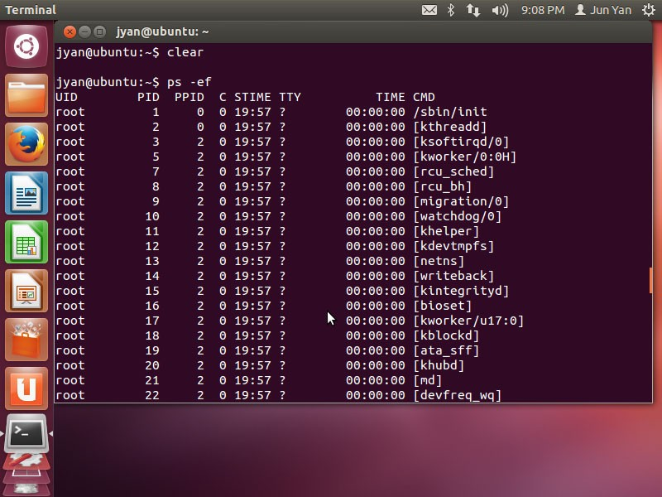

Slide 87
What can I see?
The user who started the process
The PID and PPID
The CPU utilisation
The time the process was started
The terminal from which the process was started
The time it has taken on the CPU
The command that started the process

Slide 88
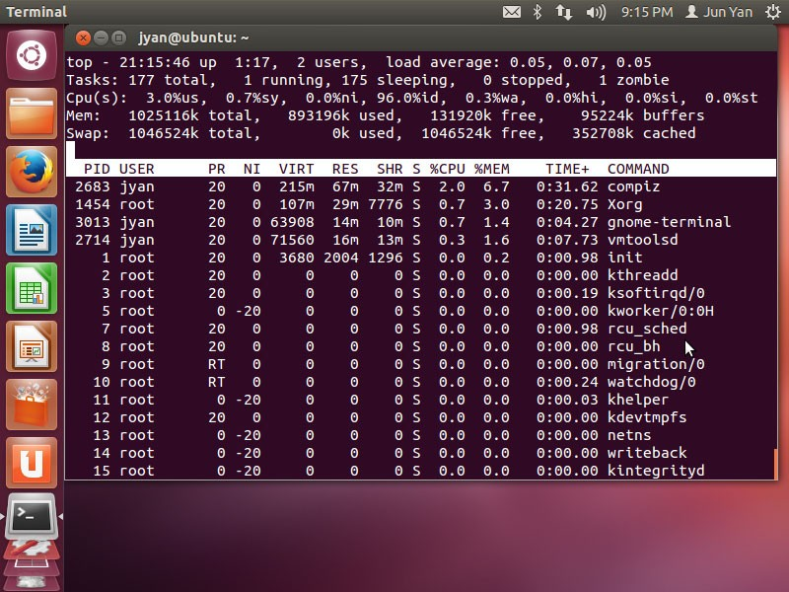
Want a dynamic real-time view of a running system? top command

Slide 89
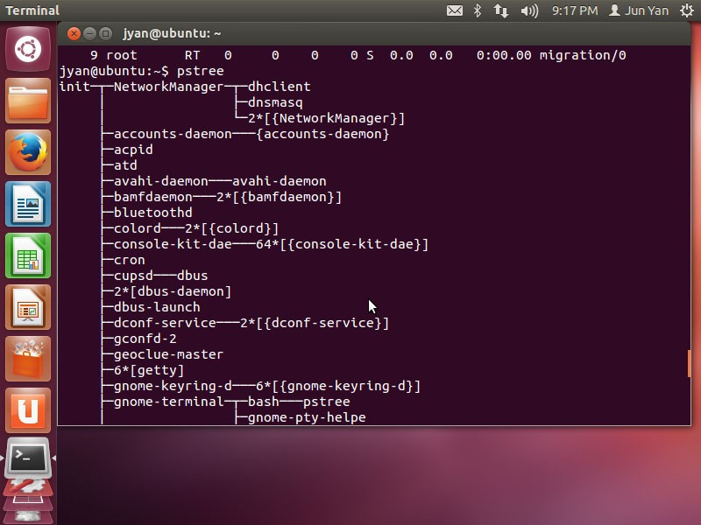
To display a tree of processes: pstree
command or ps axjf

Slide 90
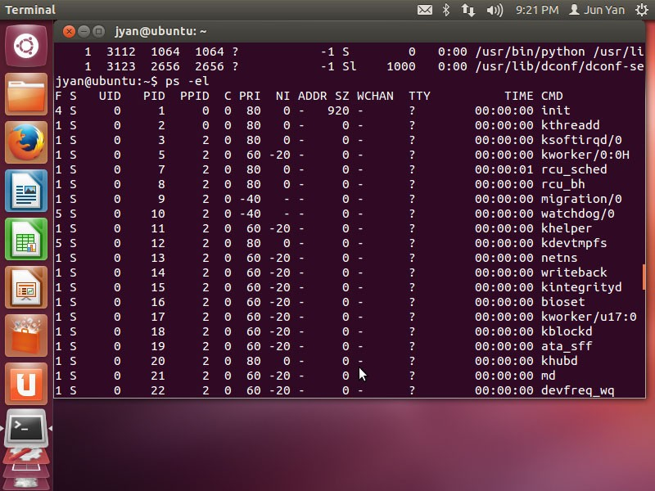
Even more information? ps -l

Slide 91
Process state (S)
The process state column is the most valuable to system administrators as it indicates what the process is currently doing
S (sleeping): the process is not being run on the processor at the current time
R (ready): the process is ready to run on the processor
O: the process is currently running on the processor
X: the process is waiting for memory
I: the process is being created
T: the process has stopped or is being traced by another process
Z: the process in a zombie process

Slide 92
Killing processes
Have you ever killed a process in Windows?
A process has encountered an error during execution and continuously uses up system resources: rogue process (has a large value in the TIME column)
The most common command to send kill signals is the
kill command
A kill command can send many different signals to a certain process
– Use $kill –l to find out

Slide 93
Useful signals use in Ubuntu
SIGHUP (1) – Hangup detected on controlling terminal or death of controlling process.
SIGINT (2) – Interrupt from keyboard.
SIGKILL (9) – Kill signal i.e. kill running process. This signal cannot be trapped by other processes but use it with caution.
SIGTERM (15) – the most common kill signal.
SIGSTOP (19) – Stop process.
SIGCONT (18) – Continue process if stopped.

Slide 94
The firefox is killing me, how can I kill it?

Slide 95
Process execution
You can execute three main types of commands
Binary programs like ls, grep
Shell functions like cd and exit
Shell scripts
When executing complied programs or shell scripts, the shell that interprets the command typed in by the user creates a new shell. This is known as forking.
The subshell then executes the program of the script
After the program is completed, the subshell kills itself and returns the control to the original shell.
The original shell uses its wait function to wait for the new shell to carry out the aforementioned tasks before returning a prompt to the user.

Slide 96
Commands run in this fashion are known as foreground processes
You can omit the wait function so that the original shell does not need to wait for the new shell to complete the task. Commands run in this fashion are known as background processes
To the run the command in the background, add a ampersand (&) to the command. The shell returns the PID of the new process.
A background process can be moved to foreground by using the fg command.
A foreground process can be paused using ctrl+z key combination and sent to the background with the bg command.

Slide 97
Process priorities
UNIX/LINUX is a multitasking operation system: multiple processes need to share the CPU time
Process priority (PRI) (0-127)is directly related to the amount of time slices a process will have on CPU. The lower the PRI, the higher the priority
You cannot directly change the PRI of a process
Nice value (NI) (0-39) indirectly influence PRI. The lower the NI, the more likely that the process will receive more time slices.

Slide 98
All users can lower the priorities of their processes buy increasing their nice value
Only the root has the ability to increase the priority of a process by lowering its nice value
Use the nice command to change the NI of a new process
Use the renice command to change the NIK of a process that has been started.

Slide 99
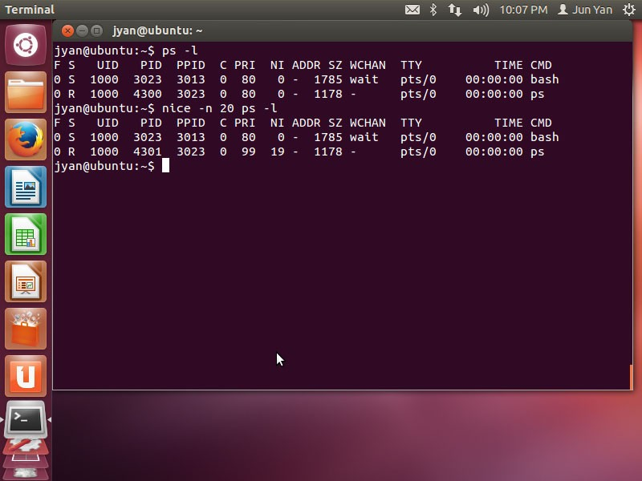

Slide 100
Scheduling process
The cron daemon on Linux runs tasks in the background at specific times; it's like the Task Scheduler on Windows

Slide 101
Scheduling commands using the at
command
at reads commands from standard input or a specified file which are to be executed at a later time, using /bin/sh.
– -t time option
The cron daemon will use the current shell’s environment when executing scheduled commands. The shell environment and scheduled commands are stored
To display a lost of at job IDs, use at -l

Slide 102
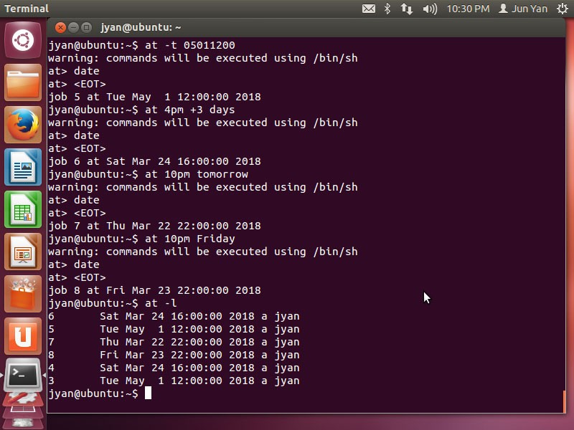

Slide 103
Scheduling commands with the
crontab command
The cron deamon uses configuration files called cron tables to specify repetitive tasks
Cron tables have six fields separated by space
Minute past the hour (0-59)
– Hour (0-23)
Day of month (1-31)
Month of year (1-12)
Day of week (0-6)
Absolute path of the command or script
– 20 17 * * 1-5 /myscript

Slide 104
Cron tables are stored in /var/spool/cron/crontabs and given the same name as the user for whom tasks are scheduled. Root users can edit or create files directly.
Normal users will use crontab –e to create and edit their own cron table
You can use the /etc/cron.d/cron.allow file to list users who have the ability to schedule tasks using the crontab command
You can use the /etc/cron.d/cron.deny file to list users who are denied the ability to schedule tasks using the crontab command
Similarly, /etc/cron.d/at.allow and /etc/cron.d/at.deny apply to the at command

